Slide 1
Design Candidates Presentation
Team 4
Hun-Min Park, Sang-Gyun An, JongMin Jin

Slide 2
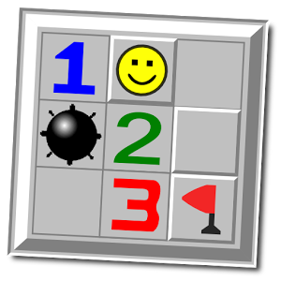
Minesweeper 3D
(박훈민)

Slide 3
Summary + Story
At last night I was playing Windows Minesweeper.
I was so sleepy and I started to dozing off.
After few minutes, I felt a strange feeling. It made me awake from the sleep.
Damn, where am I? I woke up in the strange place with grids and buttons.
The floor I was standing was opened and showed a number.
I soon found that this place looks so similar to the minefield I saw in the game.
Suddenly, a voice came from the sky : “Open all the cells without a mine. You can’t escape from this place before you complete that. Good luck”

Slide 4
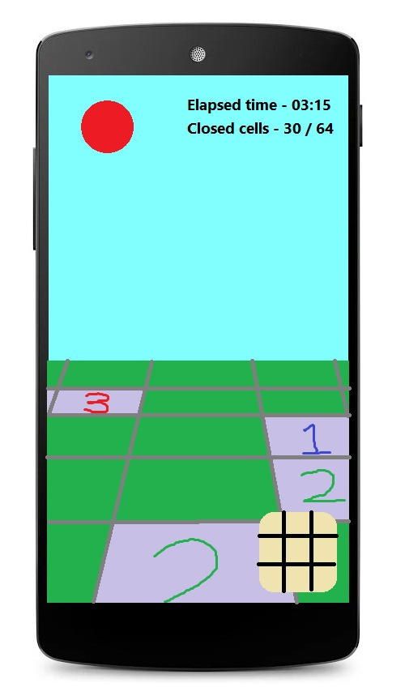
UI Prototype: Basic interface
Information about elapsed time since start,
closed (i.e not opened) cells, etc.
Closed cell
Opened cell
Movement pad

Slide 5
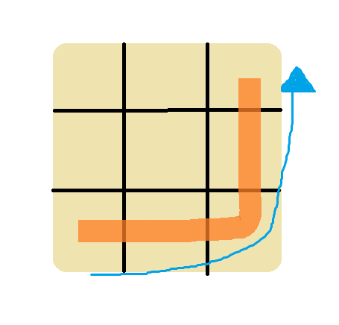
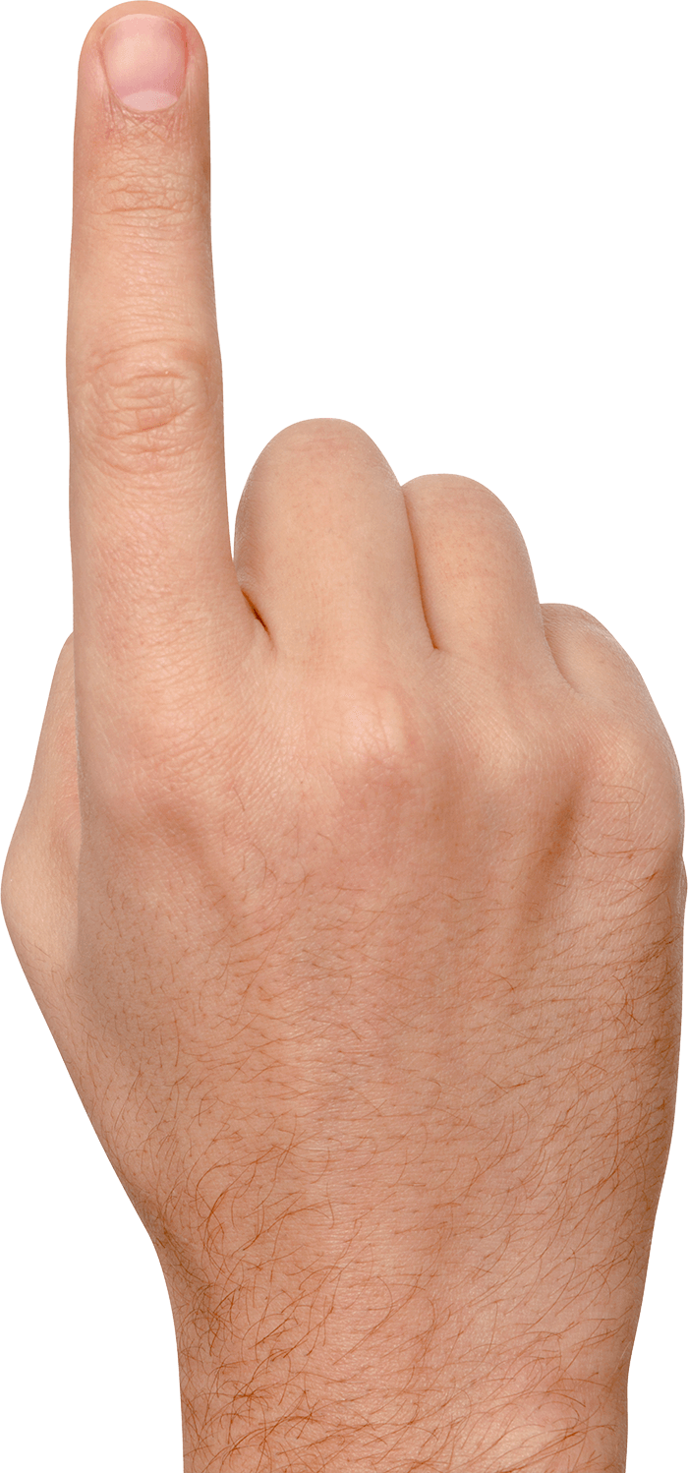
UI Prototype: Movement
-> Jump to (x+2, y+2)

Slide 6
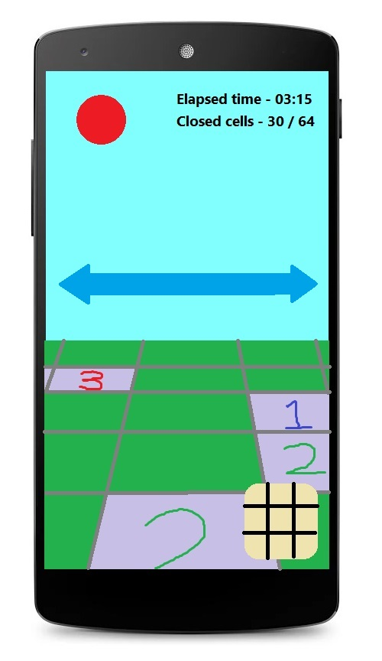
UI Prototype: Rotate
Swipe the screen to left / right
-> Rotate the camera to left / right

Slide 7
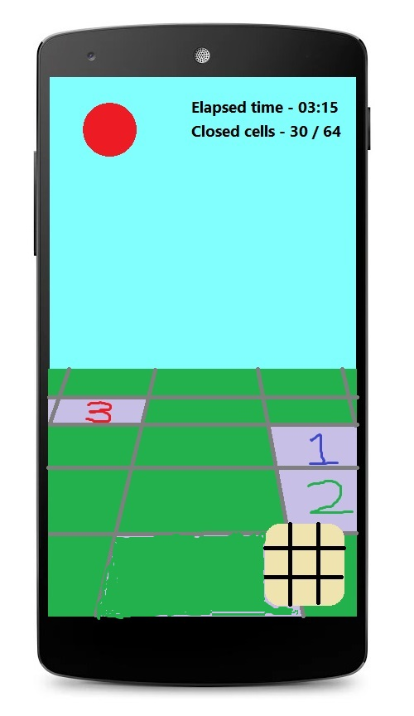

UI Prototype: Open the cell
Move to the new cell
Cell is opened

Slide 8
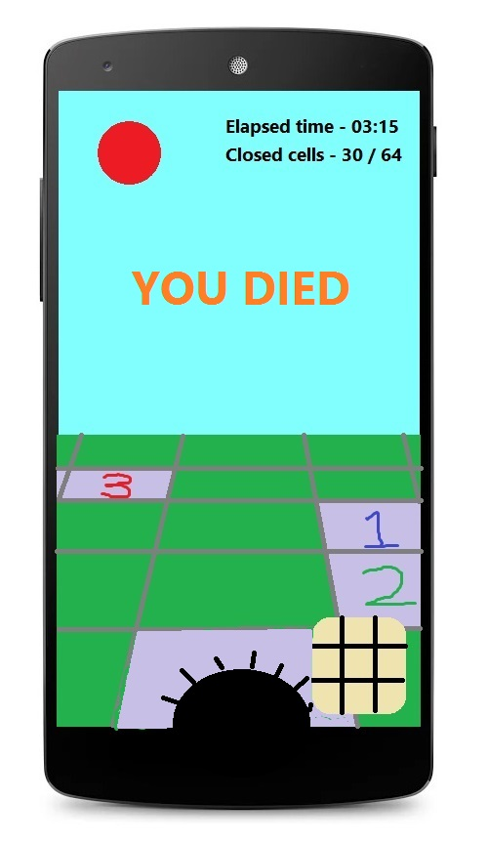
UI Prototype: Open the cell
Move to the wrong cell
Boom!

Slide 9
System Design
Android program
Execution environment
Mine generator
User
Touch screen
Timer
Vibrator
Renderer

Slide 10
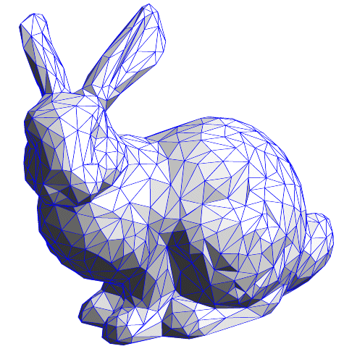
Shading Quiz
Sang-Gyun An
Notes:
I am sang gyun.
I will introduce two candidates.
First one is shading quiz.

Slide 11
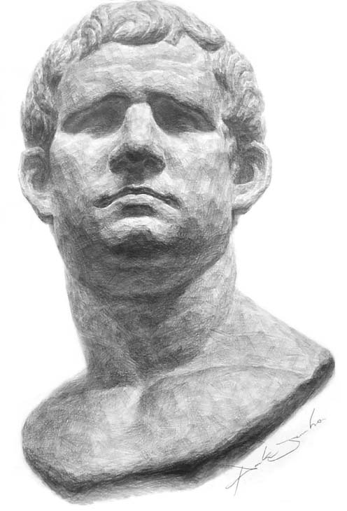
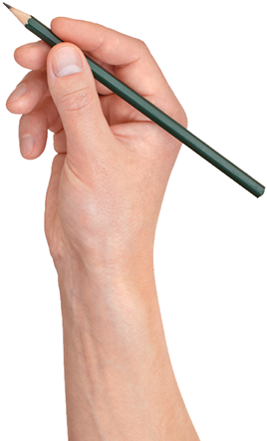
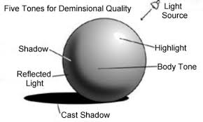
Summary
Shading is a drawing to express levels of darkness.
It needs basic calculation to know brightness of specific area.
Presentation Technique (ID217).
Make shading as a quiz!
Notes:
Basically, as a drawing, shading is a drawing to depict levels of darkness.
Fundamentally, it needs…
In fact, currently, I am TA of presentation technique course in industrial design. I and my professor found that many students have hard time to learn shading. And professor proposed ‘why don’t we make it as a quiz game?’.
So, I bring a part of that idea into this class.

Slide 12
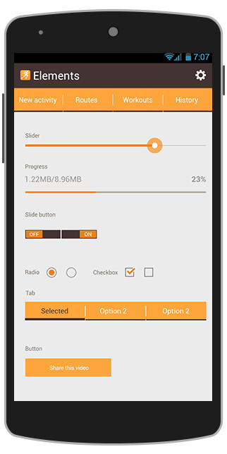
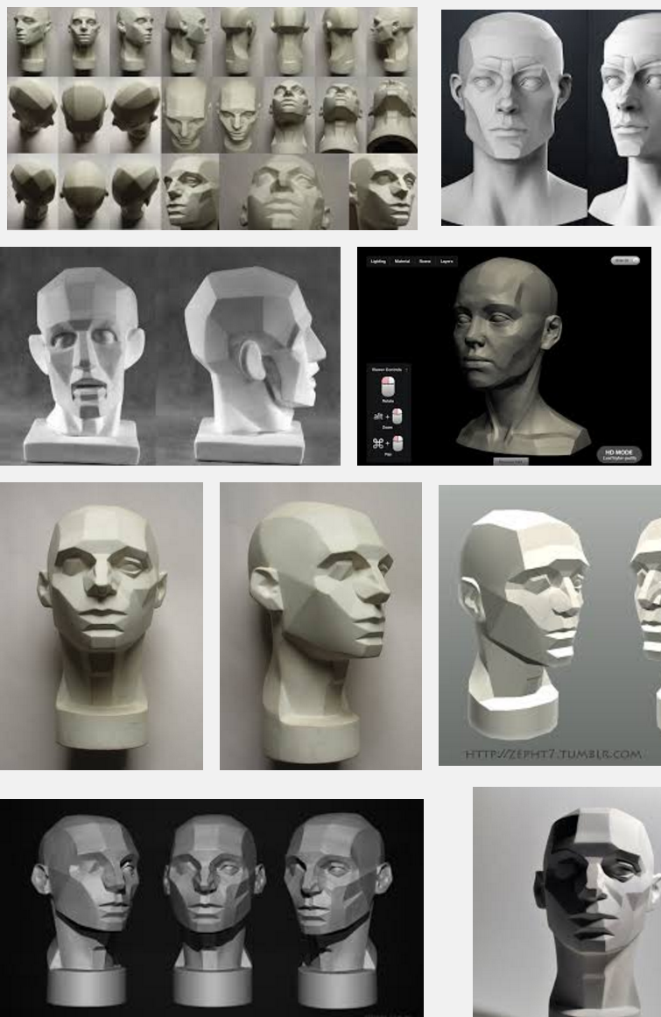

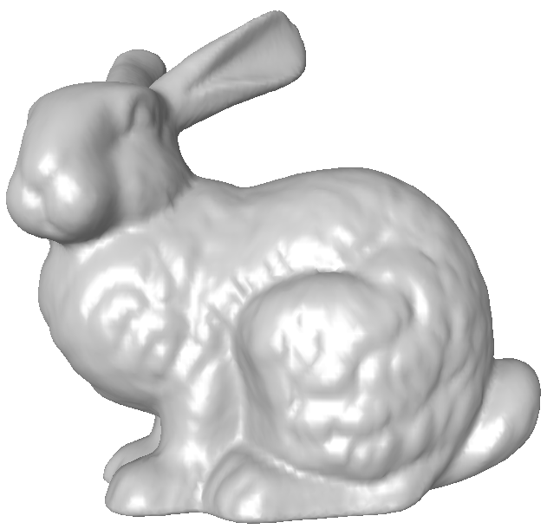
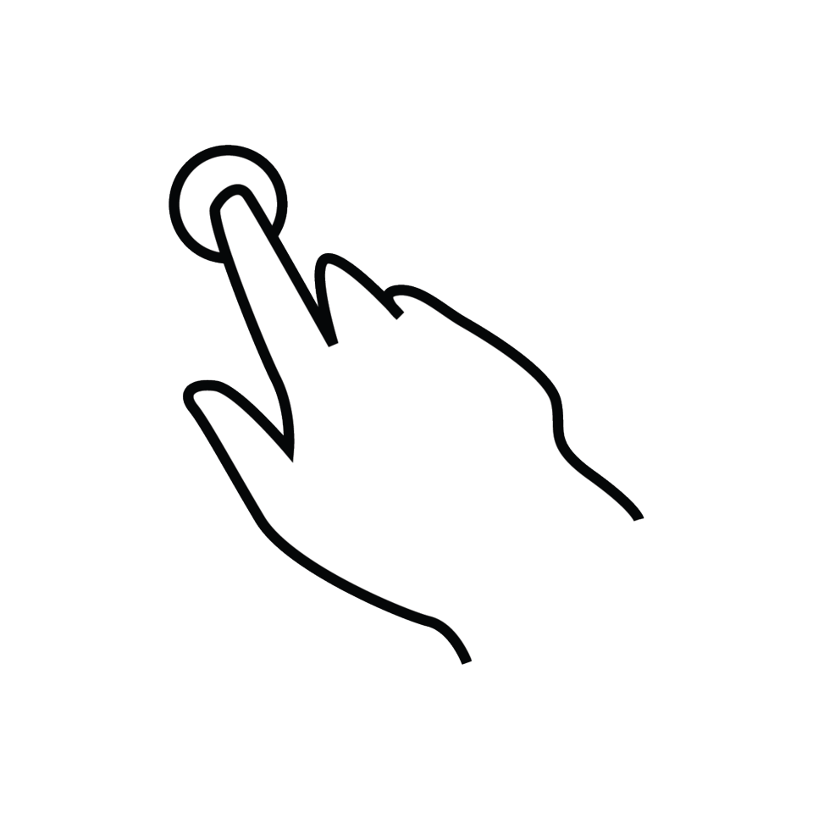
UI Prototype: Pick a 3D Model
Notes:
At first, user picks one of 3d models.
And rotate it until having a specific view to shade.

Slide 13
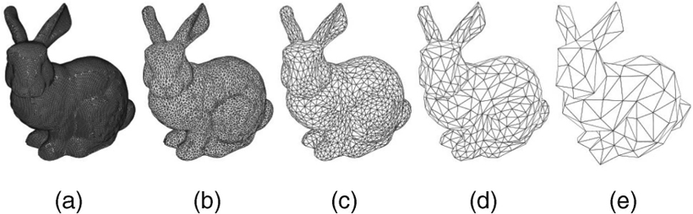
UI Prototype: Change difficulty by resolution
Easy
Hard
Notes:
Also, by modifying the resolution of the model, user can change the level of difficulty.

Slide 14
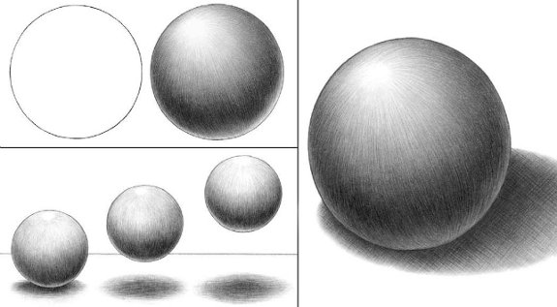
UI Prototype: Globe
Notes:
It gives a globe for shading.

Slide 15
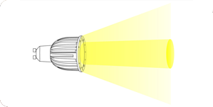
UI Prototype: Globe (Lighting condition)
Notes:
This globe can implicate the light condition.

Slide 16
UI Prototype: Globe (color chooser)
Notes:
Also, user can use it as a gray-color chooser by touching on specific area of globe.

Slide 17
UI Prototype: Coloring
Notes:
And user can apply the color on specific area or triangle of the model

Slide 18
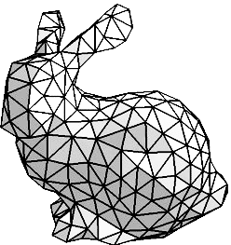
UI Prototype: Scoring
Notes:
When shading is done.

Slide 19
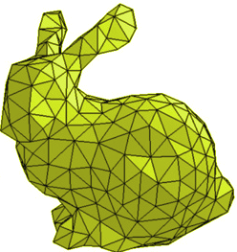
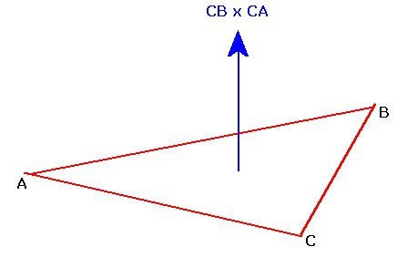
UI Prototype: Scoring
Notes:
The application internally compares the result made by user with a calculated model using normals, light, camera and etc.

Slide 20
UI Prototype: Scoring
90% Accurate
Notes:
And it can give the score or accuracy as a result of quiz.

Slide 21
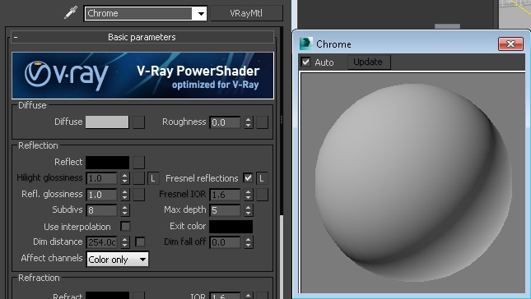
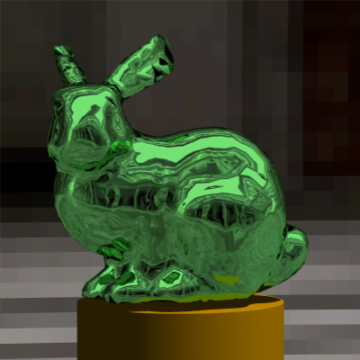
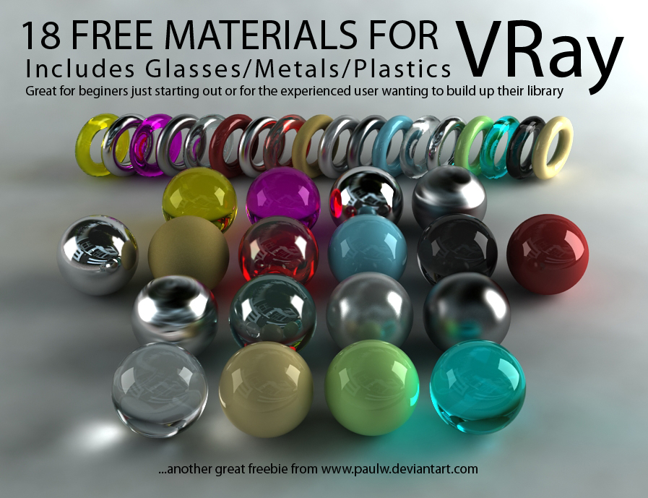
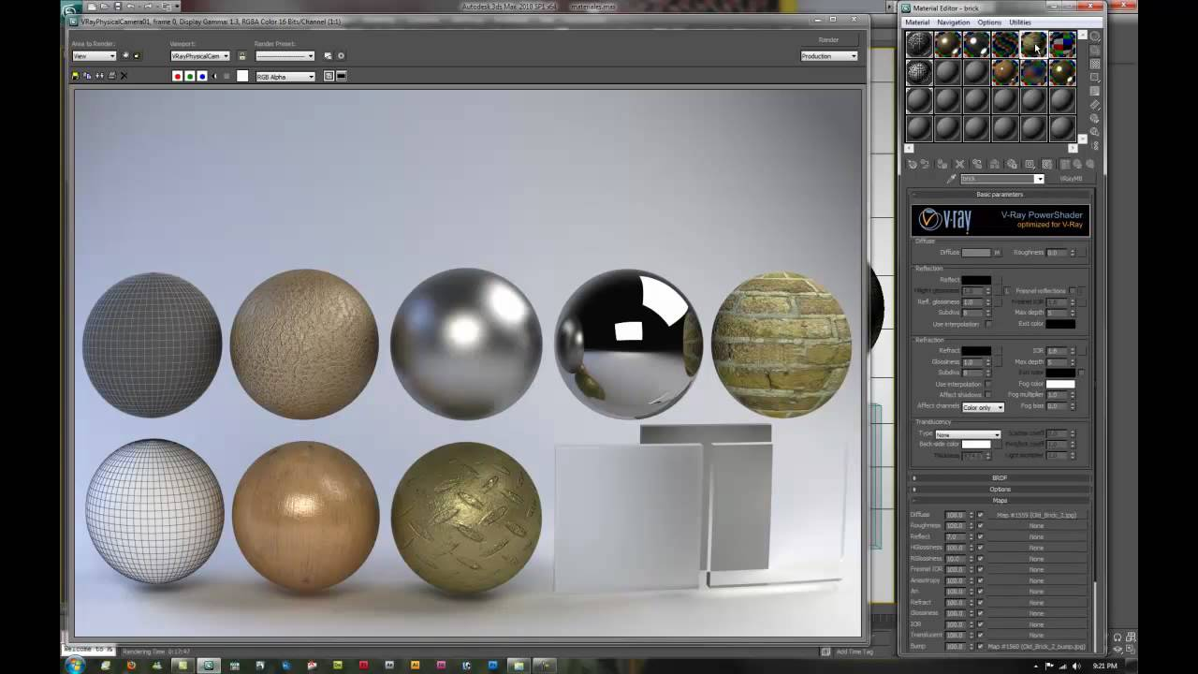
UI Prototype: Changing difficulty by material
Easy
Hard
Notes:
In addition, at the beginning of the game, user might choose material for model which makes game more challenging.

Slide 22



System Design
Execution environment
Android
program
User
View
Android device
Light
Input
Renderer
Touch screen
Feedback
...
Vibrator
Notes:
It is a single-playing quiz game.
it doesn’t need any server or external DataBase.
It runs on local Android device.

Slide 23

Blowing Bubble
Sang-Gyun An
Notes:
The second one is blowing bubble.

Slide 24
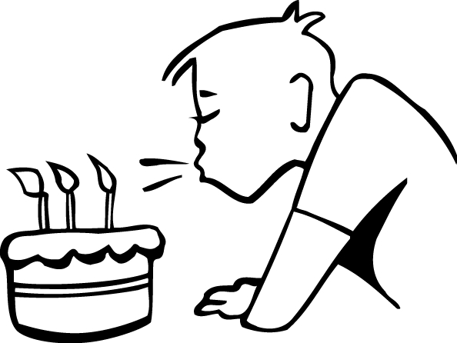
Story + Summary
We used to play with soap bubbles.
Fly a bubble and steer the direction by blowing it.
Try to fly a bubble as far as you can while avoiding obstacles.
Bubble
Notes:
Everybody used to play with soap bubbles.
Fly a bubble and steer the direction by blowing it.
It is a game trying to fly a bubble as far as you can while avoiding obstacles.

Slide 25
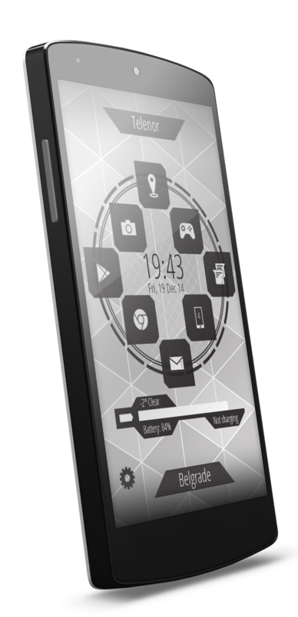
UI Prototype: To sense blow
Notes:
To sense the blow, it uses sound level sensor embedded in Android device.

Slide 26
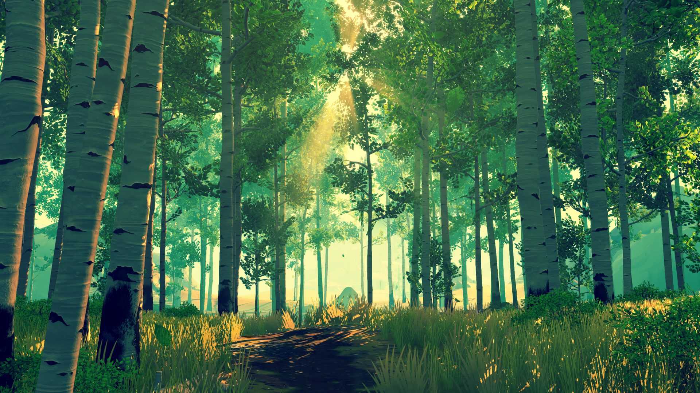


UI Prototype: Blow to start
Start
Flying
Notes:
At first, it needs blow to fly bubble.
Basically, camera sustains the tail-view of the bubble by following it.

Slide 27
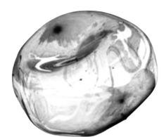
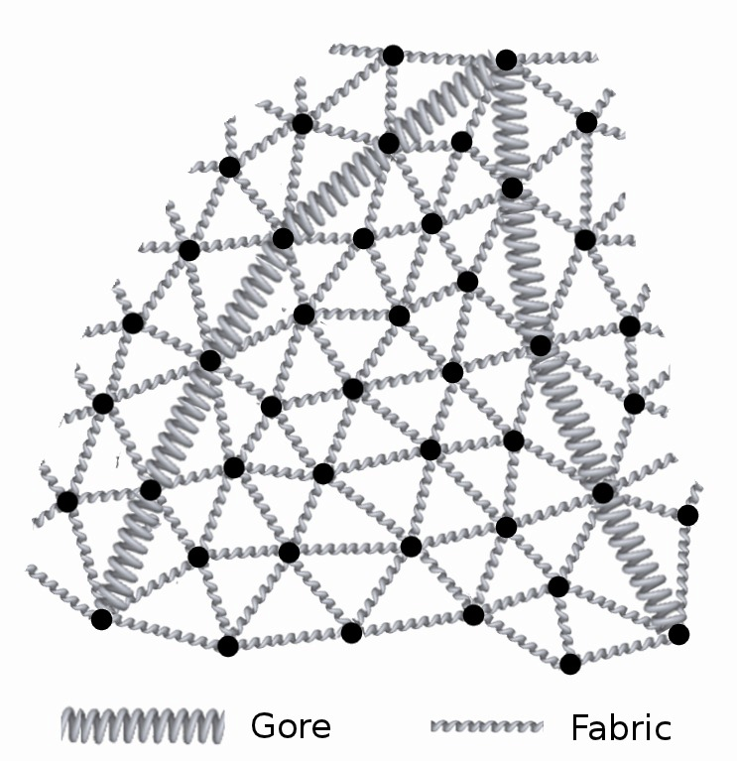
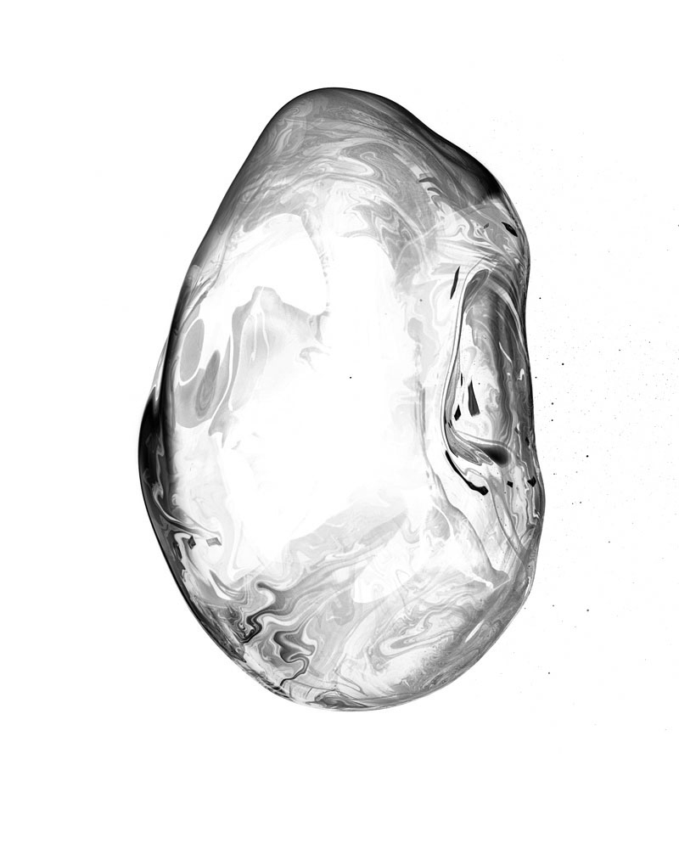
UI Prototype: Naturally Squashed Bubble
Spring-mass model?
Start
Flying
Notes:
According to user’s blow, it might simulate natural squashing behavior of bubble using spring-mass model.

Slide 28
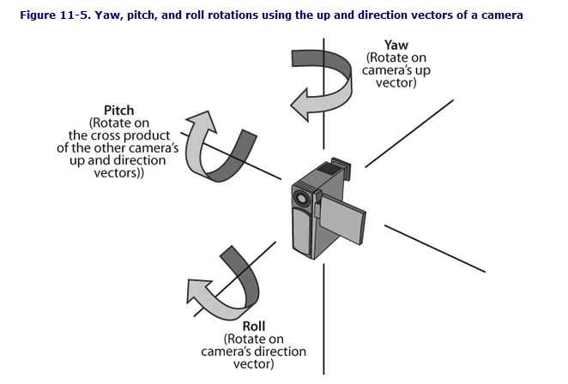
UI Prototype: Tilting to Look around
Notes:
User can look around the bubble by tilting and rotating the device.

Slide 29
UI Prototype: Blow bubble in normal direction
Notes:
And user can blow the bubble in current normal direction of screen.

Slide 30
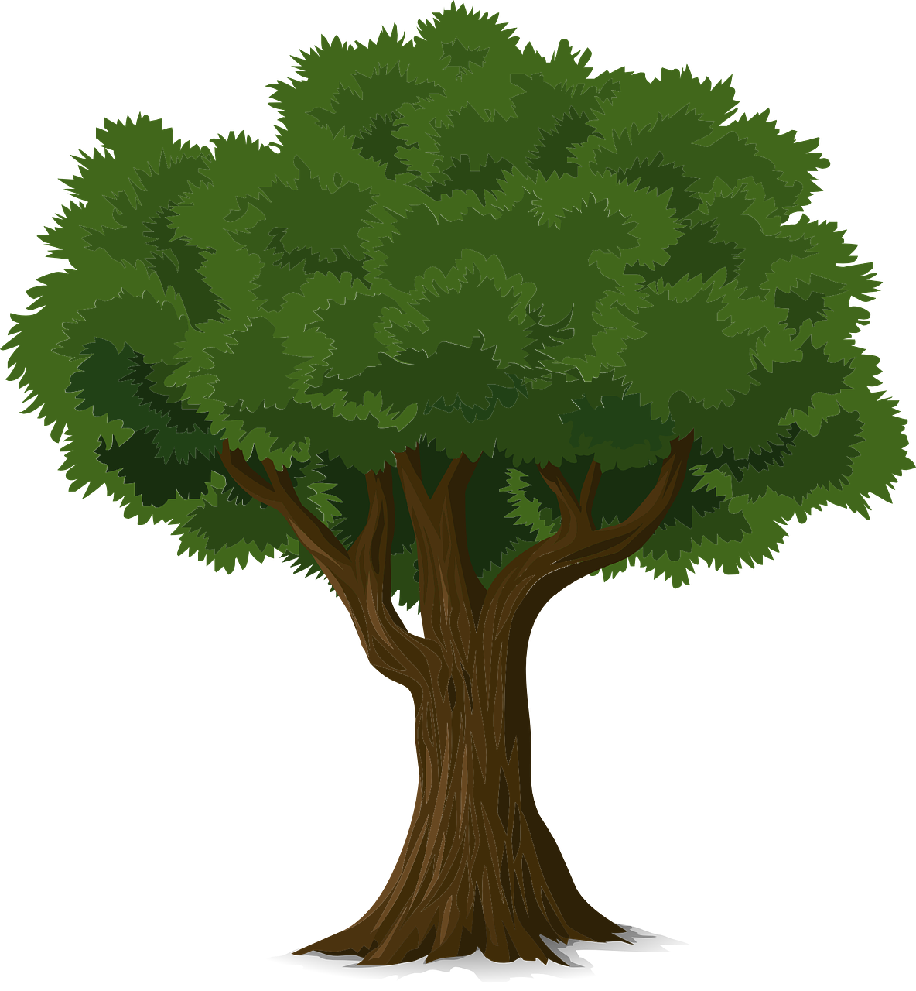
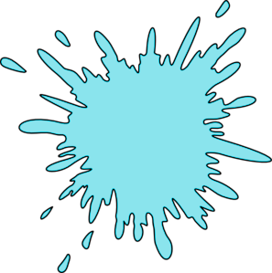
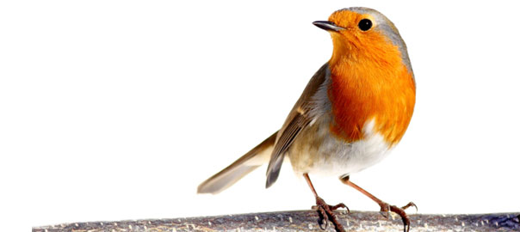
UI Prototype: Bubble Bursts + Record
3.4km
Notes:
When bubble hits obstacles including trees or birds something like that,
the bubble bursts and the record pops up.

Slide 31
System Design
Execution environment
Android
program
User
View
Android device
Map generator
Input
Basic geometry
Volume level sensor
Renderer
Input
Physics engine
Gyroscope sensor
Collision handler
Feedback
Vibrator
...
Notes:
It is also single-playing game without server or external DB.
It runs on local Android device.
Next presenter is 종민

Slide 32
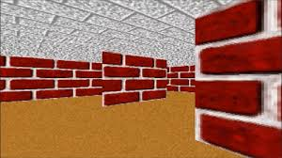
Maze explorer
(진종민)

Slide 33
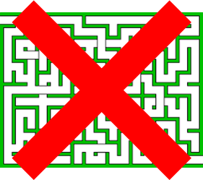
Summary + Story
Escape the maze!
First person game
No minimap!
There are monsters at some cul-de-sacs
You can use drill to drill wall
Day&night
Difficulty : easy(trace) of difficult (no trace)

Slide 34
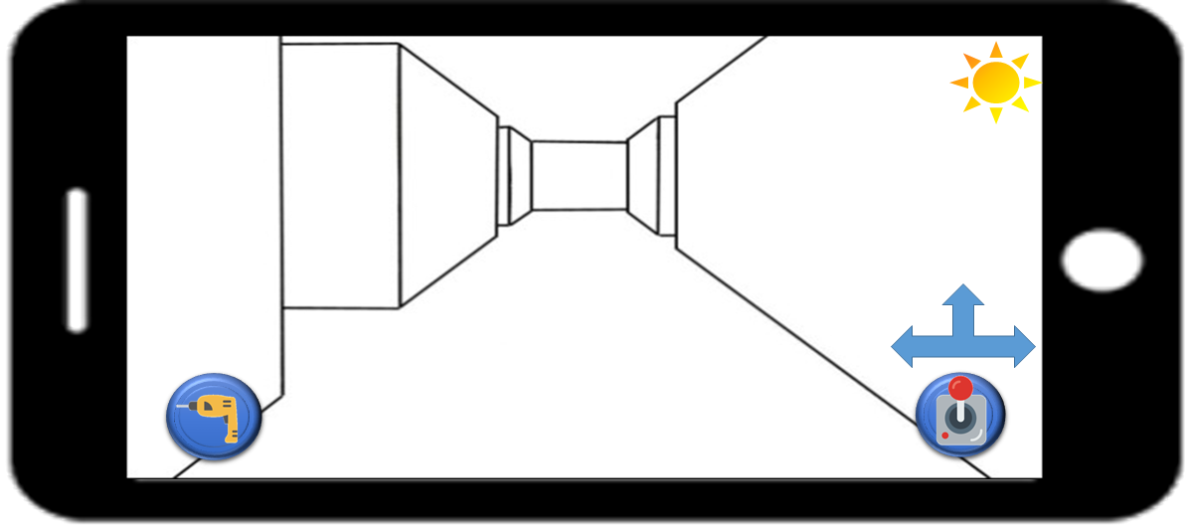
UI Prototype : Movement

Slide 35
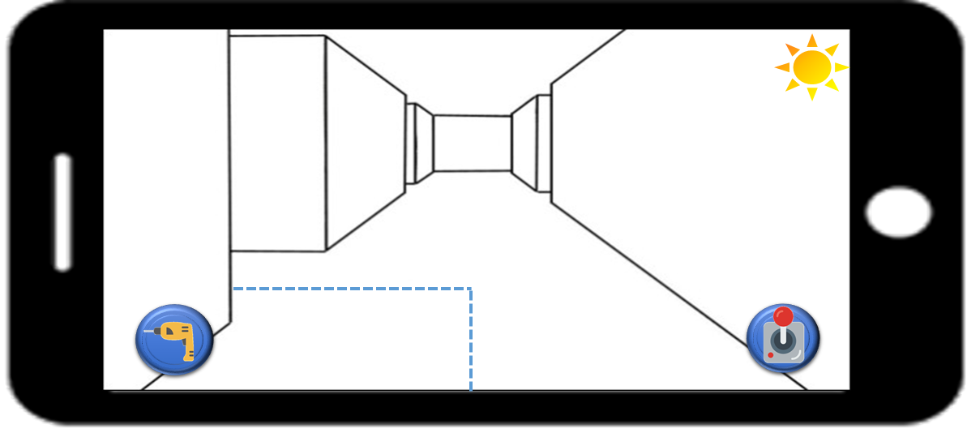
UI Prototype : Trace

Slide 36
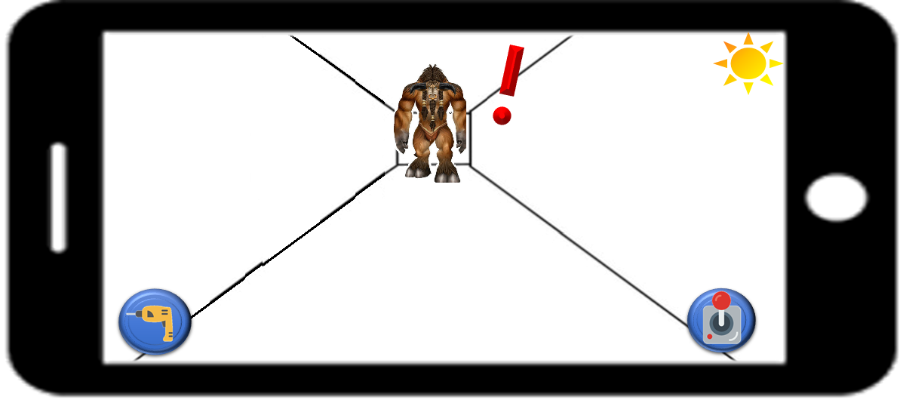
UI Prototype : Monster

Slide 37
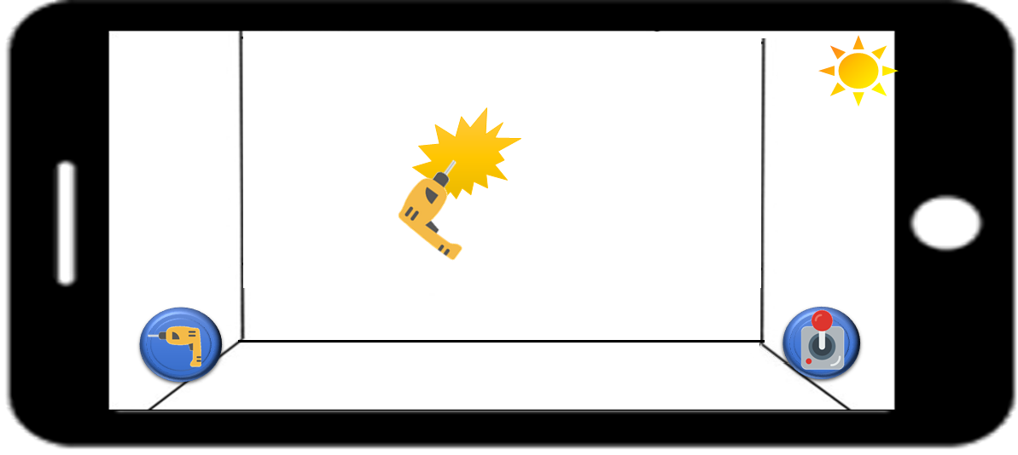
UI Prototype : Drilling

Slide 38
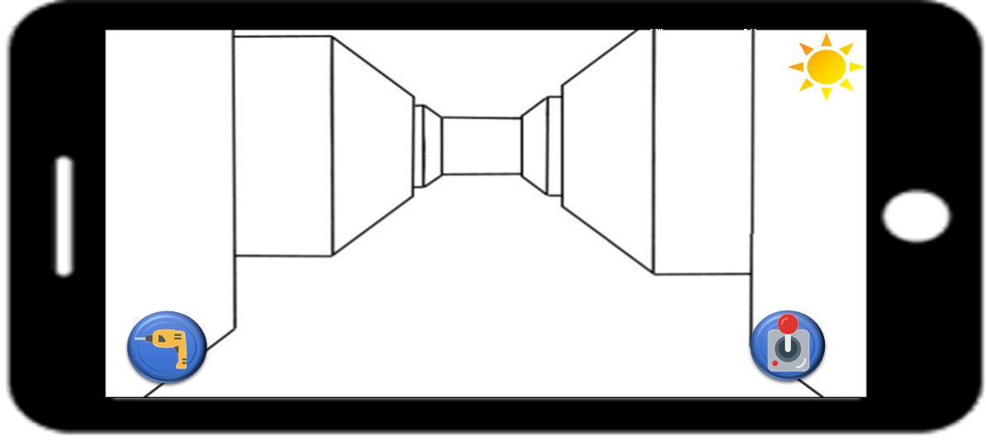
UI Prototype : Drilling

Slide 39
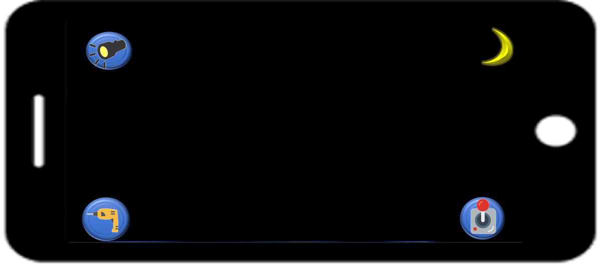
UI Prototype : Night mode

Slide 40
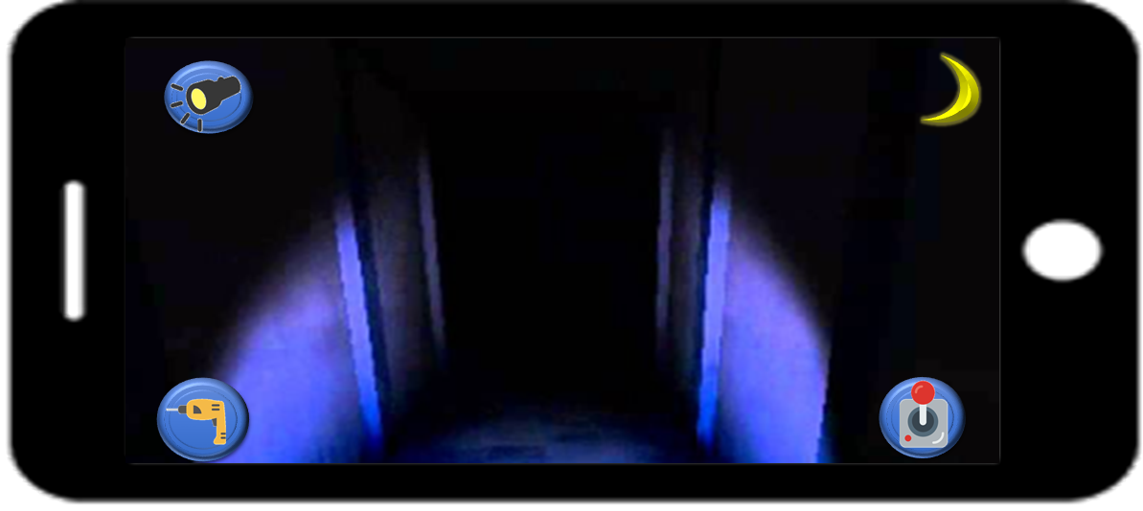
UI Prototype : Night mode

Slide 41

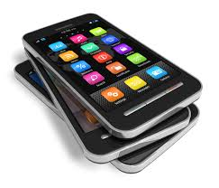
System Design
Android
program
User
Android device
Map generator
View
AI
Touch
Renderer
Light

Slide 42
Let’ Vote!!
3D Minesweeper
Shading Quiz
Blowing Bubble
Maze Explorer

